Slide 1
Analysis Of Rheological Properties Of Egg-Yolk
Rheology Of Complex Fluids-Project Presentation
Furqan
Augustine

Slide 2
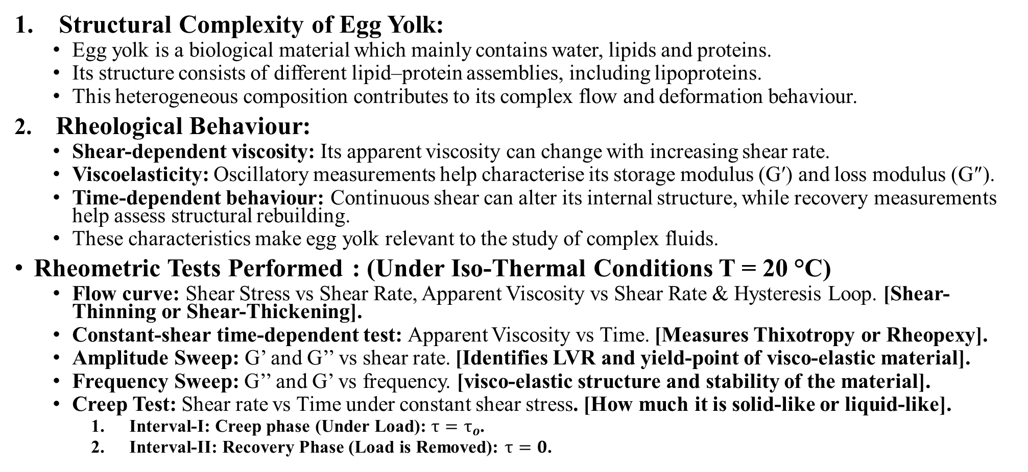
Significance of the material related to Rheology of Complex Fluids:
Structural Complexity of Egg Yolk:
  Egg yolk is a biological material which mainly contains water, lipids and proteins.
  Its structure consists of different lipid–protein assemblies, including lipoproteins.
  This heterogeneous composition contributes to its complex flow and deformation behaviour.
2. Rheological Behaviour:
  Shear-dependent viscosity: Its apparent viscosity can change with increasing shear rate.
  Viscoelasticity: Oscillatory measurements help characterise its storage modulus (G′) and loss modulus (G″).
  Time-dependent behaviour: Continuous shear can alter its internal structure, while recovery measurements help assess structural rebuilding.
  These characteristics make egg yolk relevant to the study of complex fluids.
Rheometric Tests Performed : (Under Iso-Thermal Conditions T = 20 °C)
  Flow curve: Shear Stress vs Shear Rate, Apparent Viscosity vs Shear Rate & Hysteresis Loop. [Shear-Thinning or Shear-Thickening].
  Constant-shear time-dependent test: Apparent Viscosity vs Time. [Measures Thixotropy or Rheopexy].
  Amplitude Sweep: G’ and G’’ vs shear rate. [Identifies LVR and yield-point of visco-elastic material].
  Frequency Sweep: G’’ and G’ vs frequency. [visco-elastic structure and stability of the material].
  Creep Test: Shear rate vs Time under constant shear stress. [How much it is solid-like or liquid-like].
    Interval-I: Creep phase (Under Load): $τ=τ_{o}$.
    Interval-II: Recovery Phase (Load is Removed): $τ=0$.

Slide 3
Summary Of Literature:
Kumbár et al. (2015) – Effect of egg storage duration on the rheology of liquid egg products. Journal of Food Engineering, 156, 45–54.
  Investigated how storage duration affects the rheological properties of liquid egg yolk, egg white and whole egg for 1 to 8 weeks stored at 4 °C.
  Apparent viscosity of liquid egg products decreased considerably with increasing storage duration.
  Egg yolk exhibited typical thixotropic and time-dependent behaviour.
  Experimental flow curves were successfully described using the Herschel–Bulkley and Power Law (Ostwald–de Waele) models.
Di Lorenzo et al. (2025) – Rheology in novel egg cooking methods. Physics of Fluids, 37, 023145.
  Investigated how different cooking methods and thermal histories influence the sol–gel transition and texture development of egg yolk and egg albumen.
  Raw egg yolk exhibited liquid-like behaviour at 20°C, with loss modulus (G″) greater than storage modulus (G′) over the investigated frequency range.
  The amplitude sweep indicated an approximately 5% strain limit for the linear viscoelastic region (LVE) of raw yolk.

Slide 4
Problem Statement:
Since Egg Yolk is a complex fluid which can show shear-dependent viscosity, viscoelasticity & time-dependent structural changes. So, A systematic experimental characterisation of fresh egg yolk is required to understand these properties.
The objective is to develop suitable rheological models using experimental data & to characterise the flow and deformation behaviour of fresh egg yolk at 20°C and evaluate suitable models to describe its rheological response.

Slide 5
Experimental Methodology:
Test | Measurement | Purpose
1. Flow-Curve | Increasing and decreasing shear-rate sweeps | Determine flow behaviour and hysteresis
2. Constant-shear rate time-dependent test | Viscosity vs. time at 54.5 s⁻¹ | Investigate thixotropic nature
3. Amplitude sweep | Strain: 0.1–100%; frequency: 10 s⁻¹ | Identify the linear viscoelastic region (LVE)
4. Frequency sweep | 100–1 rad/s; strain: 1% | Determine storage and loss moduli
5. Creep–recovery | Constant stress followed by zero-stress recovery | Investigate deformation and structural recovery

Slide 6
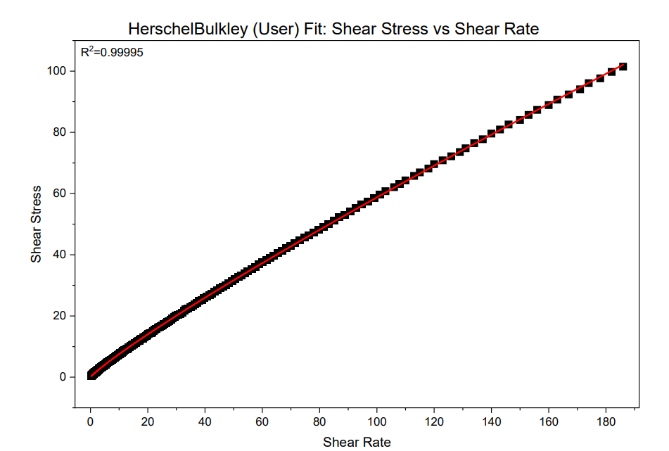
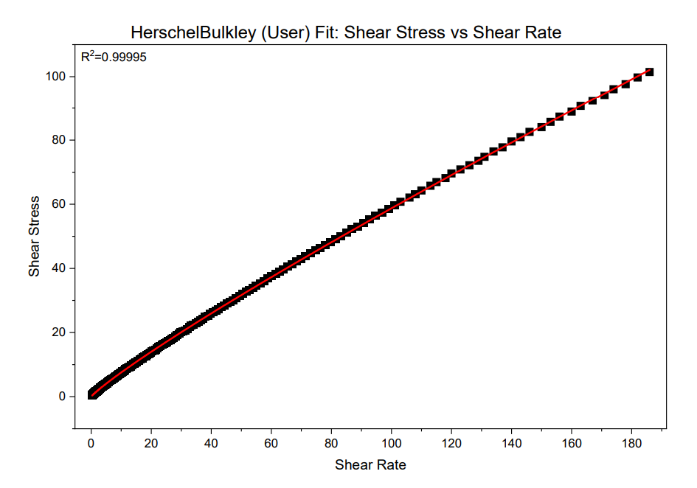
Results & Discussions:
Hershel-Bulkley Model: All the graphs are generated in OriginPro
Forward Pass
Backward Pass

Slide 7
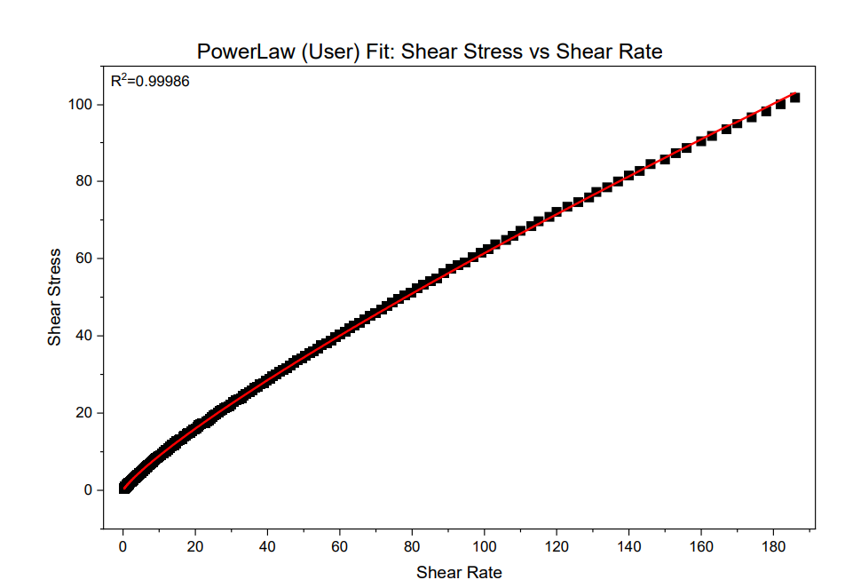
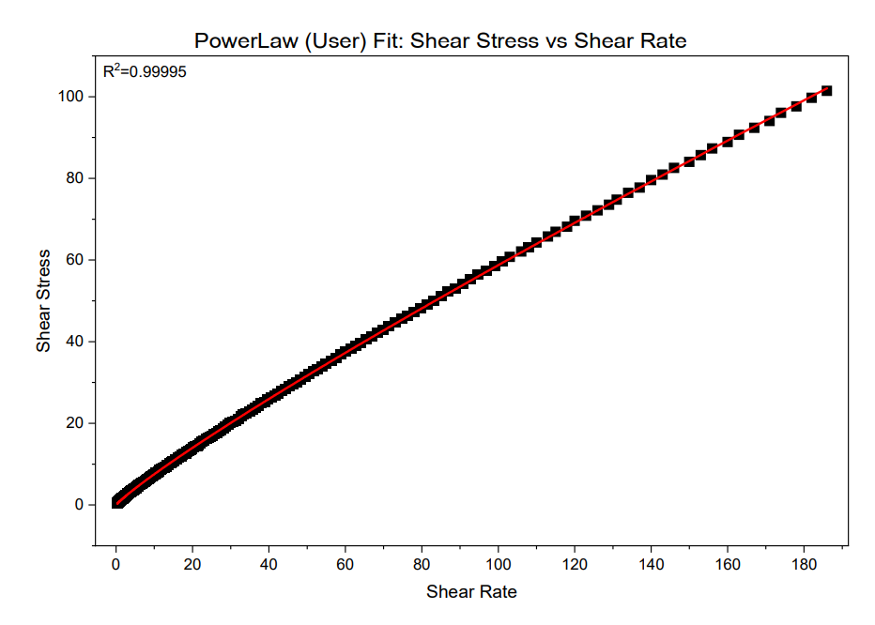
Power Law Model:
Forward Pass
Backward Pass

Slide 8
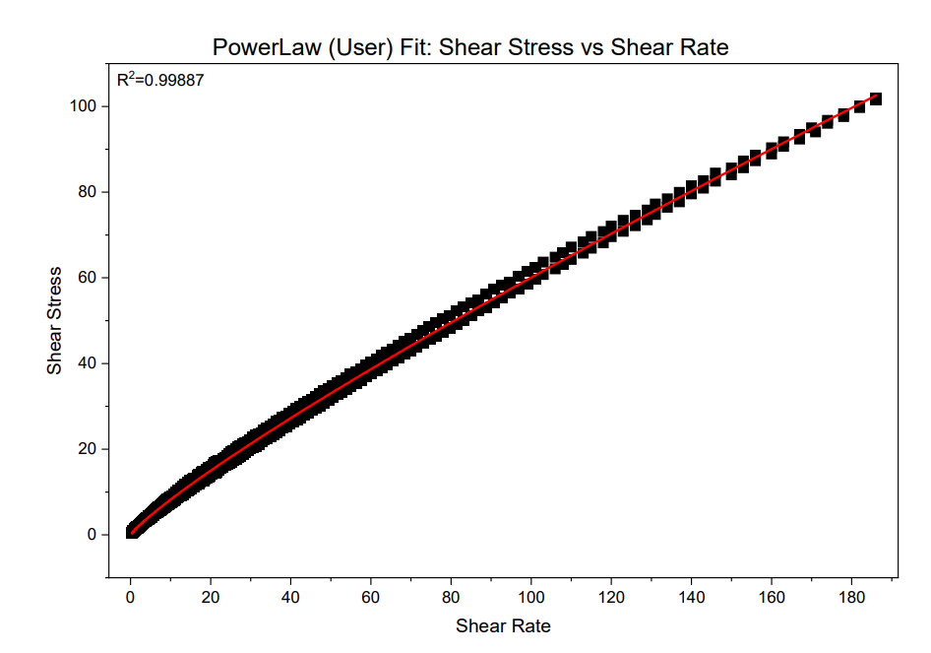
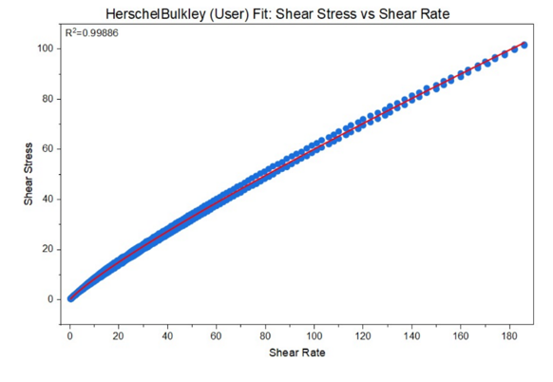
Hysteresis:

Slide 9
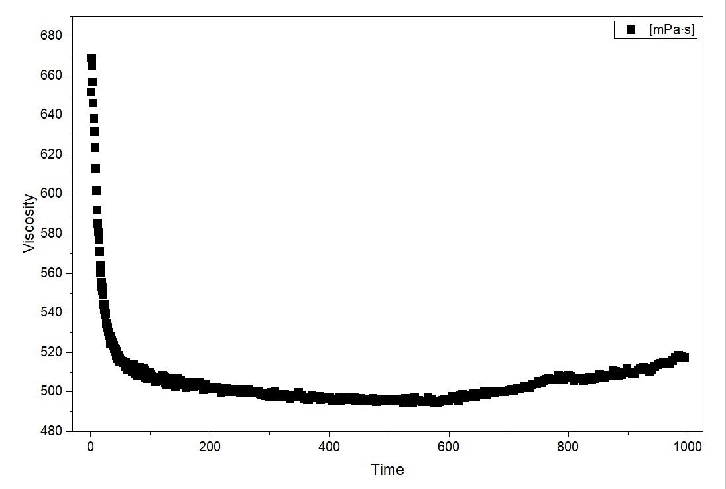
Constant-Shear Time-Dependent Test:

Slide 10
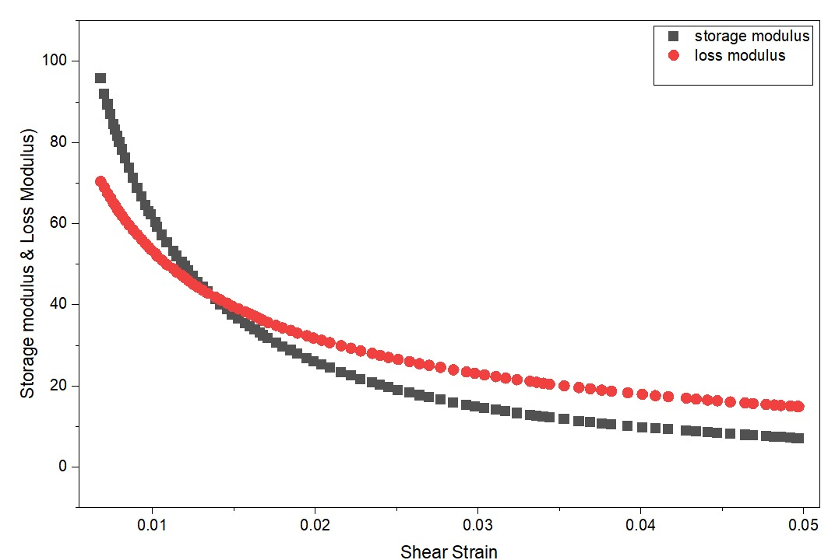
Amplitude Sweep:

Slide 11
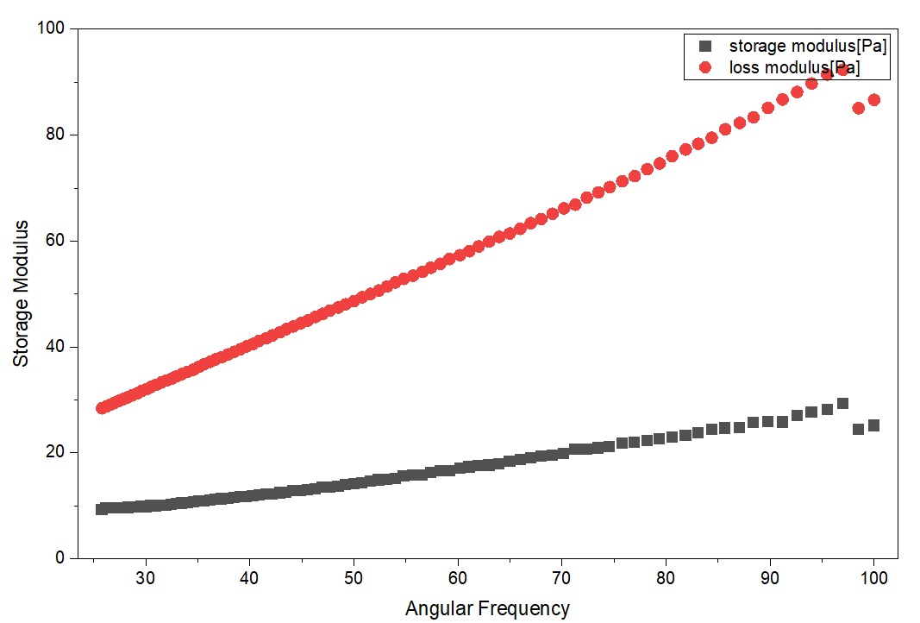
Frequency Sweep:

Slide 12
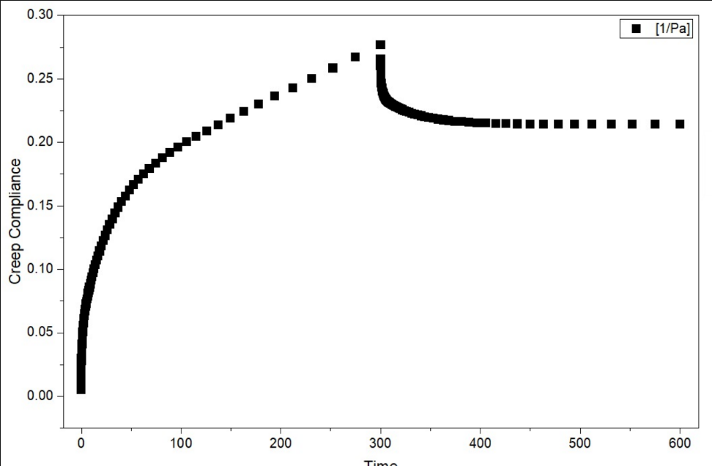
Creep Test:
%Recovery = 21.8%

